Slide 1
Jenkins – Day 2
Venkatachalam Mani - 532146

Slide 2
Agenda
Jenkins tool
System Configuration
Security
Status Information
Troubleshooting
Tools and Actions
Uncategorized
Item types
Freestyle
Pipeline
Job Template
Folder
Multi branch pipeline
Use Case

Slide 3
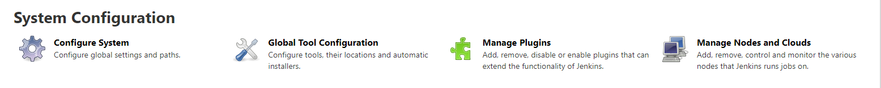
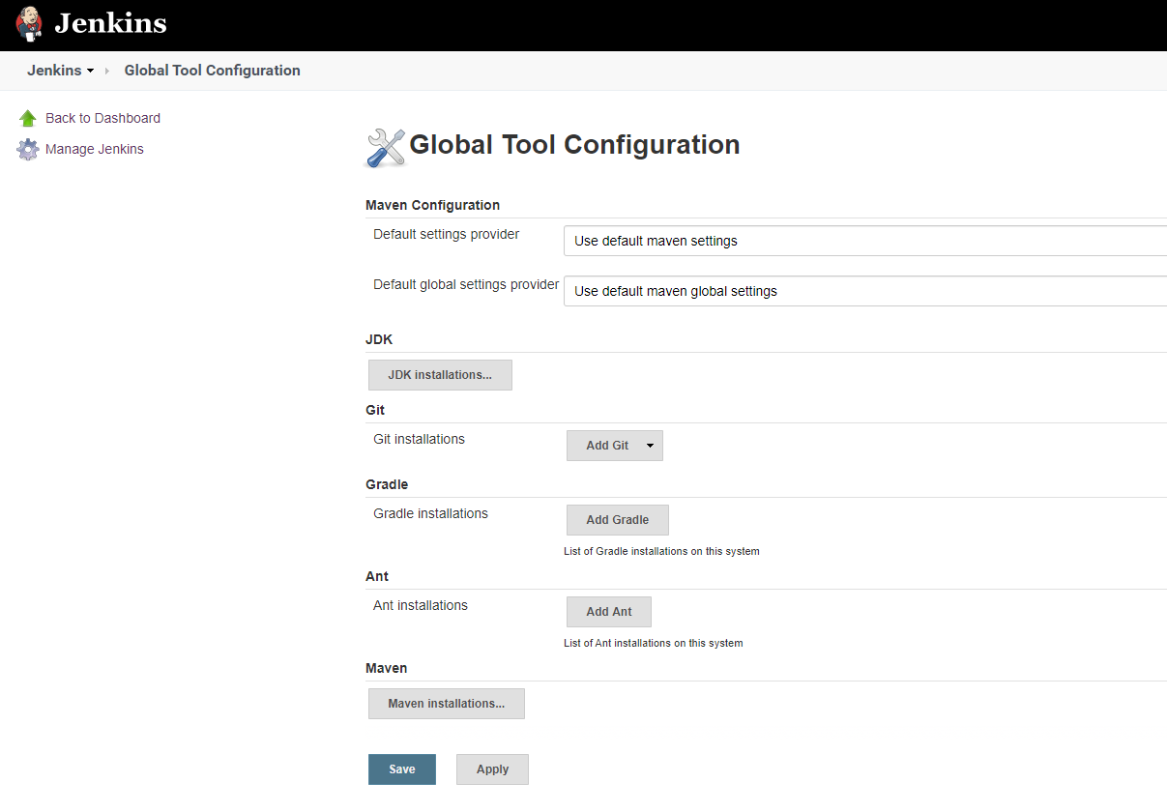
System Configuration
With the help of environment variables we can set the variables for Jenkins wide usage

Slide 4
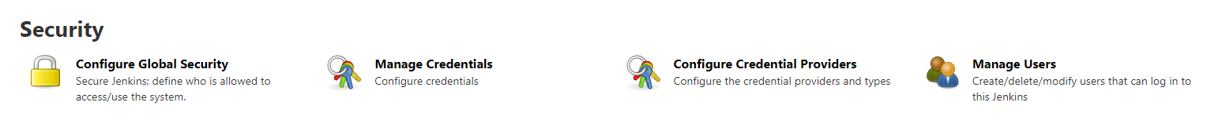
Security
Status Information

Slide 5
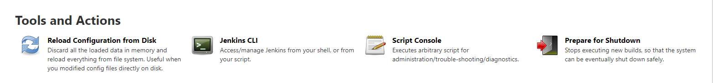
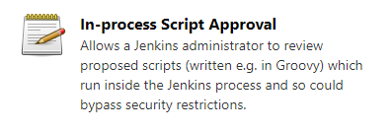
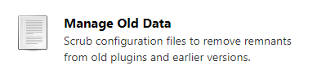
Other
Tools And Actions

Slide 6
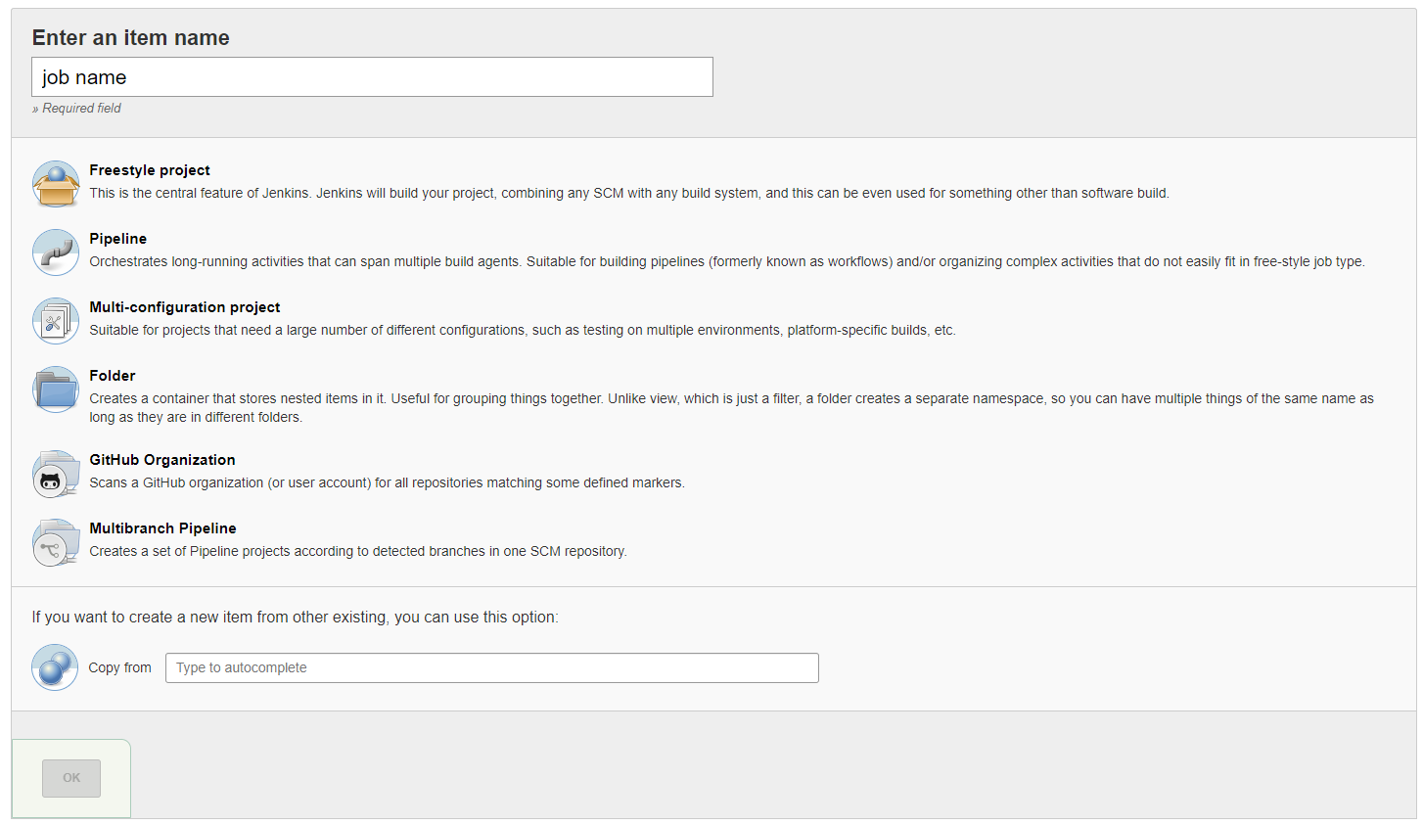
Jenkin Item Types

Slide 7
Freestyle Jobs
Freestyle means improvised or unrestricted.
A freestyle project in Jenkins is a project that spans multiple operations.
It can be a build, a script run, or even a pipeline.
A freestyle project is a typical build job or task.
This could be as
simple as running tests,
Building or packaging an application,
sending a report, or even running some commands.
A real-world scenario could involve, for instance, the collection of application artifacts after builds. In relation to management, Jenkins allows us to send reports at any defined stage, which could entail artifact information, or shipping application logs to a log management entity, such as Elasticsearch.

Slide 8
Jenkins Pipeline
Jenkins Pipeline (or simply "Pipeline") is a suite of plugins which supports implementing and integrating continuous delivery pipelines into Jenkins.
A continuous delivery pipeline is an automated expression of your process for getting software from version control right through to your users and customers.
Jenkins Pipeline provides an extensible set of tools for modeling simple-to-complex delivery pipelines "as code". The definition of a Jenkins Pipeline is typically written into a text file (called a Jenkinsfile) which in turn is checked into a project’s source control repository. ^{[1]}
For more information about Pipeline and what a Jenkinsfile is, refer to the respective Pipeline and Using a Jenkinsfile sections of the User Handbook.

Slide 9
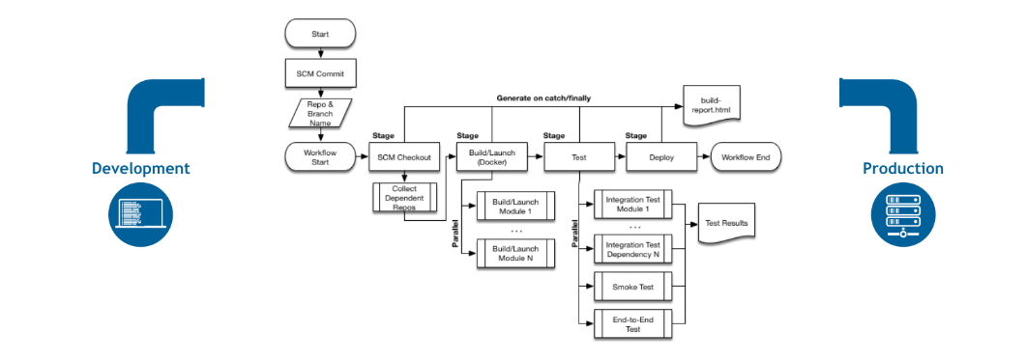
Pipeline !!!
Code – Durable – Pausable – Versatile - Extensible

Slide 10
Pipeline Concepts
Code – Durable – Pausable – Versatile - Extensible
Pipeline
A Pipeline is a user-defined model of a CD pipeline. A Pipeline’s code defines your entire build process, which typically includes stages for building an application, testing it and then delivering it.
Also, a pipeline block is a key part of Declarative Pipeline syntax.
Node
A node is a machine which is part of the Jenkins environment and is capable of executing a Pipeline.
Also, a node block is a key part of Scripted Pipeline syntax.
Stage
A stage block defines a conceptually distinct subset of tasks performed through the entire Pipeline (e.g. "Build", "Test" and "Deploy" stages), which is used by many plugins to visualize or present Jenkins Pipeline status/progress.
Step
A single task. Fundamentally, a step tells Jenkins what to do at a particular point in time (or "step" in the process). For example, to execute the shell command make use the sh step: sh 'make'. When a plugin extends the Pipeline DSL, ^{[1]} that typically means the plugin has implemented a new step.

Slide 11
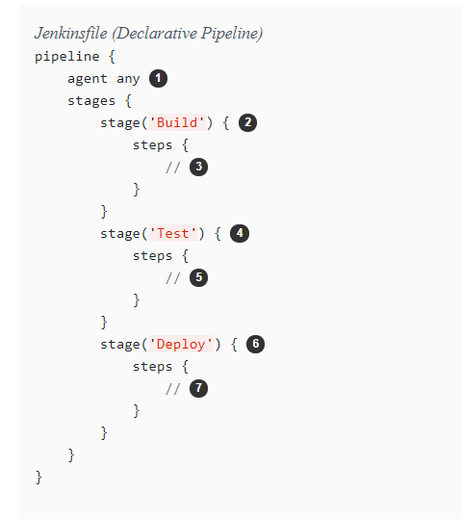
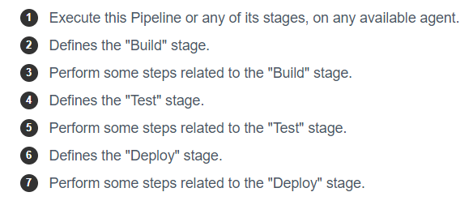
Pipeline types
Declarative pipeline

Slide 12
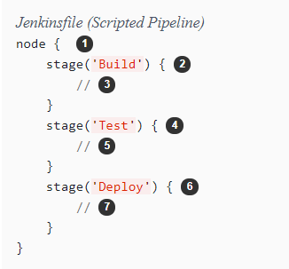
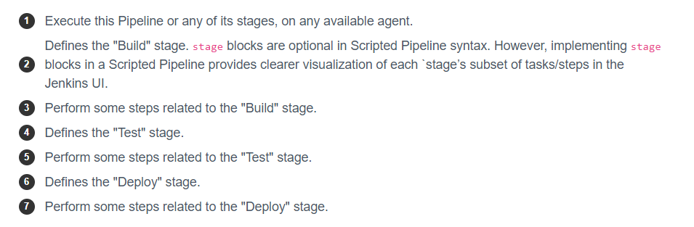
Pipeline types
Scripted pipeline

Slide 13
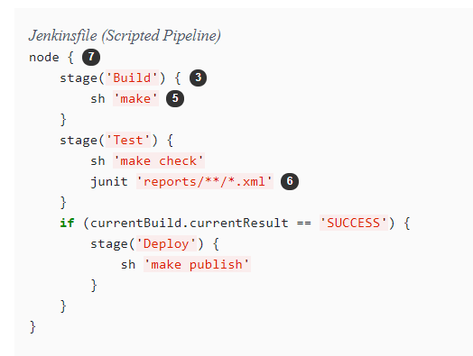
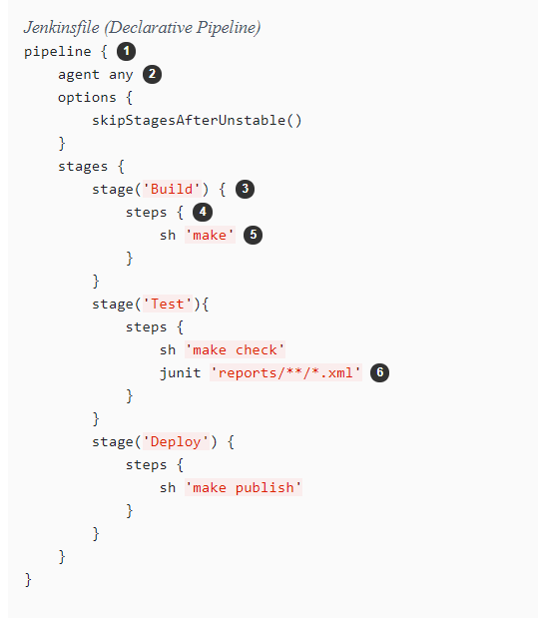
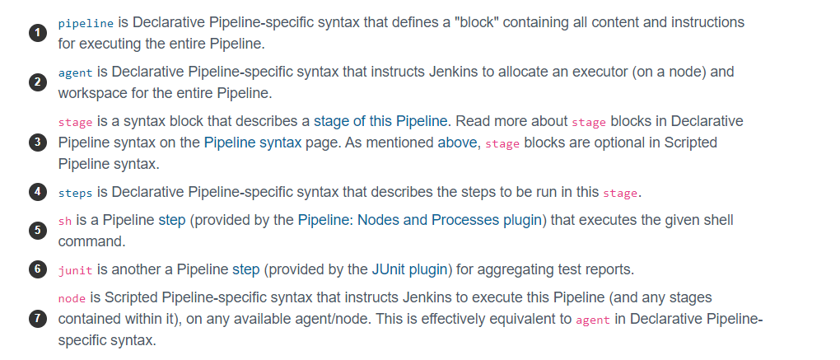
Pipeline Example

Slide 14
Use Cases 1. Build a maven project, source from GitHub 1. Freestyle 2. Pipeline 2. Build a sample declarative pipeline project 3. Build a sample scripted pipeline project

Slide 15
Thank You!

